Slide 1
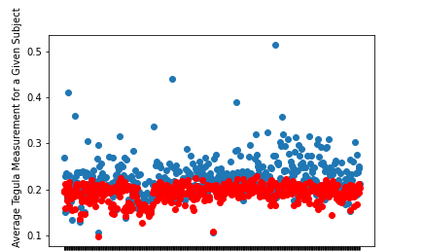
Four Cheadle Center Researchers Conducted their own Measurements and Results were Compared to Contributions by Community Scientists from Notes for Nature
Averaged 13.7% difference between researchers’ average tegula measurement and community scientists average tegula measurement.
Statistically significant difference when comparing community scientists’ measurements as a whole to researchers’ measurements with an independent samples T-test (P-Value = 6.0 x 10^-46).
Red = researchers
Blue = community scientists
Given Subject (Image)

Slide 2
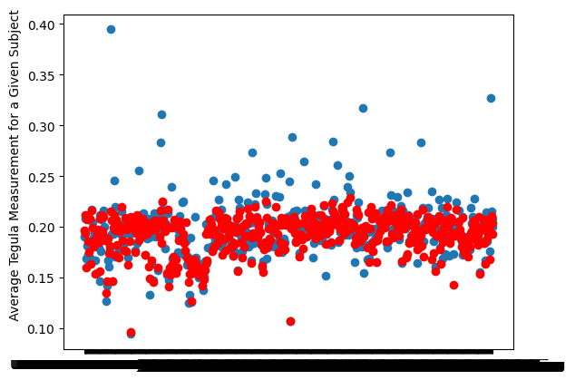
Four Cheadle Center Researchers Conducted their own Measurements and Results were Compared to Contributions by Community Scientists from Notes for Nature Round 2
Averaged 5.3% difference between researchers’ average tegula measurement and community scientists average tegula measurement.
Statistically significant difference when comparing community scientists’ measurements as a whole to researchers’ measurements with an independent samples T-test (P-Value = 3.9 x 10^-3).
Red = researchers
Blue = community scientists
Given Subject (Image)

Slide 3
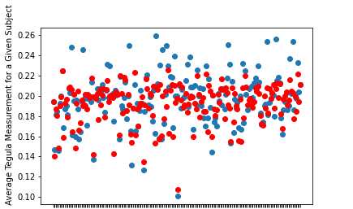
Several Methods were Considered to Improve Accuracy of Data
Biggest change in P-Value derived from considering only certain images.
Remove images that lack precise data from analysis by only considering ones where community scientists managed to produce 3+ measurements within 10% of each other.
Only analyze the 193 / 479 images left after this and only consider the measurements that met the 10% criteria.
Compare Researchers’ average measured Tegula Distance to community Scientists’ average measurement for each image.
Average percent difference = 5.24%.
Community Scientists measure 2.2% higher than researchers on average.
Statistical significance from independent samples T-test comparing Researchers’ measurements to Community Scientists’ (P-Value = 0.033).
Given Subject (Image)

Slide 4
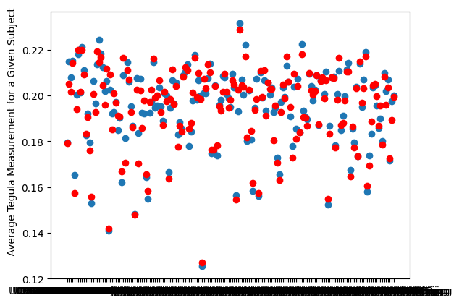
Several Methods were Considered to Improve Accuracy of Data in Round 2
Remove images that lack precise data from analysis by only considering ones where community scientists managed to produce 3+ measurements within 10% of each other.
Only analyze the 175 / 479 images left after this and only consider the measurements that met the 10% criteria.
Compare Researchers’ average measured Tegula Distance to community Scientists’ average measurement for each image.
Statistical significance from independent samples T-test comparing Researchers’ measurements to community Scientists’ (P-Value = 0.81).
Given Subject (Image)

Slide 5
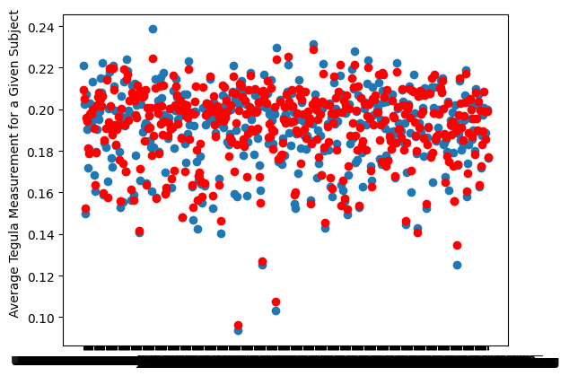
Several Methods were Considered to Improve Accuracy of Data in Round 2
Remove images that lack precise data from analysis by only considering ones where community scientists managed to produce 3+ measurements within 50% of each other.
Only analyze the 419 / 479 images left after this and only consider the measurements that met the 50% criteria.
Compare Researchers’ average measured Tegula Distance to community Scientists’ average measurement for each image.
Statistical significance from independent samples T-test comparing Researchers’ measurements to community Scientists’ (P-Value = 0.26).
Given Subject (Image)

Slide 6
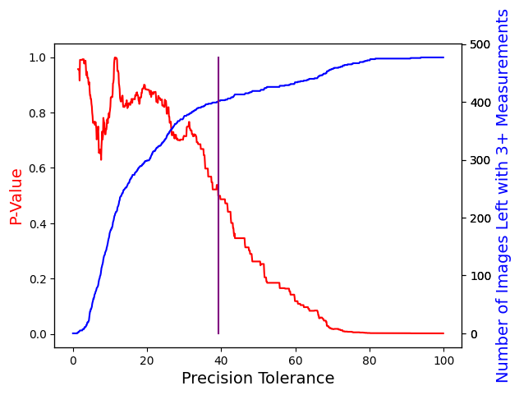
How Can We Determine the Best Precision Cutoff?
Requiring images to have more precise results in fewer usable images.
Requiring less precision results in a higher P-Value.
Therefore, we are exchanging P-Value (Quality) for Number of Viable Images (Quantity).
Happy Medium at precision tolerance of 39.2% (Purple Line).
This keeps 402 / 479 images.
This puts us at a P-Value of 0.5 (No indication of any statistically significant difference between researchers and community scientists).
*Higher precision tolerance means we allow LESS precise results (A.K.A. results that are further from the other measurements for a given image)

Slide 7
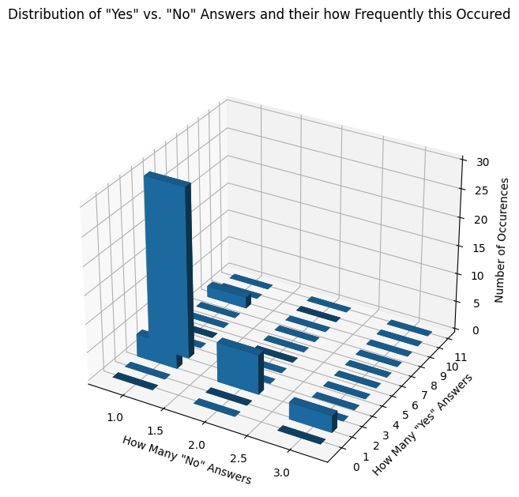
Why did some images have more than five measurements?
Distribution of how many measurements answered “Yes” to “Were you able to measure the bee?“ vs. how many answered “No” for a given image and how frequently this occurred.
Peaks at (1,4), (2,3) and (3,2) indicate 5 total measurements to be the norm despite unconfident answers.
People tend to maintain confidence despite inability to measure certain images properly (such as those with antennae covering a tegula).
We expect unconfident answers to be very prevalent on certain images, but we only ever saw three at most.

Slide 8
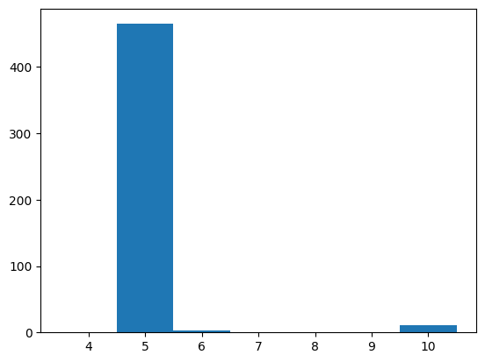
Why did some images have more than five measurements?
Almost all measurements had exactly 5 measurements, as expected.
Some had 6 measurements, and some had 10.
It is unknown why this variation occurs.
Previously, some images had any number of measurements between 5 and 14.
Number of Images with this many Measurements
Number of Measurements

Slide 9
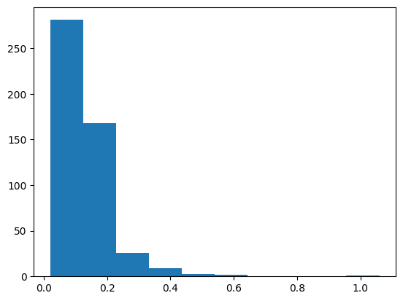
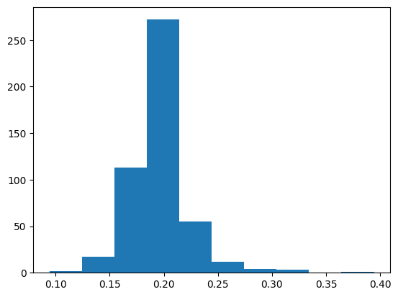
Why Does Notes for Nature Reconciled Data Still Differ from ours?
Their Reconciled Data
Number of Occurrences
Notes for nature averages all measured X-coordinates and Y-coordinates for a given image, not individual measurements (as we do).
This means if some users select the top of the tegula first and some select the bottom first, the reconciled coordinate average will be in the middle
Similarly, users not selecting the exact same block on the scalebar will greatly skew measurements when coordinates are averaged.
They have averaged tegula lengths up to 0.6 cm due to skewed scalebars.
Most of their measurements average very low (< 0.1 cm) due to some users measuring left to right and others measuring right to left (or down to up vs. up to down depending on image orientation).
Tegula Measurement Length
Our Reconciled Data
Number of Occurrences
Tegula Measurement Length

Slide 10
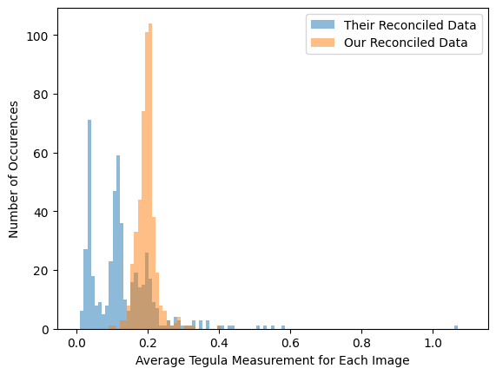
Why Does Notes for Nature Reconciled Data Still Differ from ours?
Notes for nature averages all measured X-coordinates and Y-coordinates for a given image, not individual measurements (as we do).
This means if some users select the top of the tegula first and some select the bottom first, the reconciled coordinate average will be in the middle
Similarly, users not selecting the exact same block on the scalebar will greatly skew measurements when coordinates are averaged.
They have averaged tegula lengths up to 0.6 cm due to skewed scalebars.
Most of their measurements average very low (< 0.1 cm) due to some users measuring left to right and others measuring right to left (or down to up vs. up to down depending on image orientation).

Slide 11
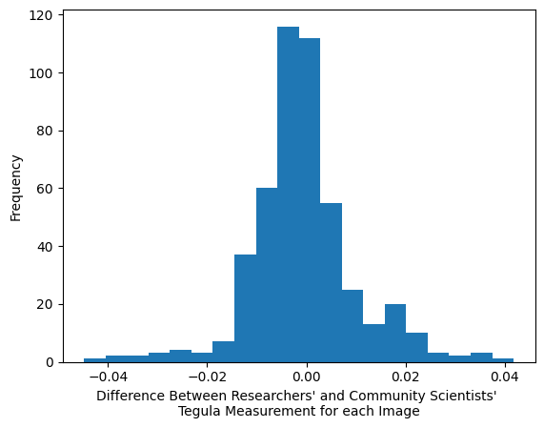
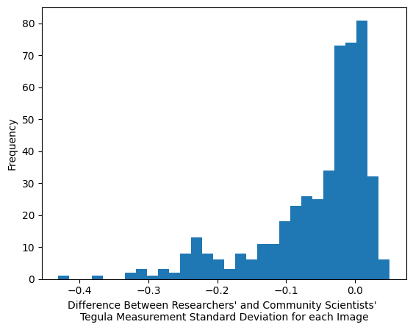
Were the Differences Between Researchers’ and Community Scientists’ Measurements Biologically Meaningful?
(standard deviation of 5 measurements for an image) / (mean of 5 measurements for an image)
Top Graph X-Axis = (Researchers’ mean of 5 measurements for an image) - (Community Scientists’ mean of 5 measurements for the same image).
Slight left skew into negative territory indicates community scientists’ measurements were slightly larger for most images.
Bottom Graph X-Axis = (Researchers’ corrected standard deviation of 5 measurements for an image) - (Community Scientists’ corrected standard deviation of 5 measurements for the same image).
Left tail into negative territory indicates community scientists’ measurements have higher standard deviation and are therefore spread further apart.
Corrected standard deviation = (standard deviation of 5 measurements for an image) / (mean of 5 measurements for an image)
This corrects for the fact that larger measurements have larger standard deviations by default.
If we assume the mean of all 5 measurements for an image isn’t the same between these two groups, we need this correction.
If the mean of all 5 measurements for an image IS the same between these two groups, this correction will still allow us to make a comparison.

Slide 12
Formula for Previous Slide
$\frac{\text{(}\text{Researchers}\text{’ }\text{standard} \text{deviation} \text{of}\text{ 5 }\text{measurements} \text{for} \text{an} \text{image}\text{)}}{\text{(}\text{Researchers}\text{′ }\text{mean} \text{of}\text{ 5 }\text{measurements} \text{for} \text{the} \text{image}\text{)}}$ - $\frac{\text{(}\text{Community} \text{Scientists}\text{’ }\text{standard} \text{deviation} \text{of}\text{ 5 }\text{measurements} \text{for} \text{an} \text{image}\text{)}}{\text{(}\text{Community} \text{Scientists}\text{′ }\text{mean} \text{of}\text{ 5 }\text{measurements} \text{for} \text{the} \text{image}\text{)}}$

Slide 13
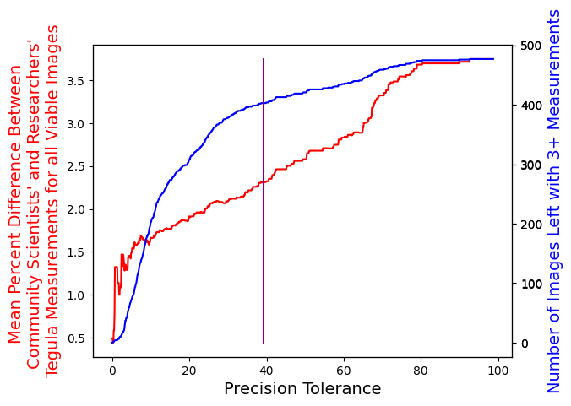
How Should we Measure the Accuracy of all Viable Images?
Conversion of P-Value to Average Difference Between Tegula Measurements as indicators of accuracy.
*Note that Average Distance goes up to indicate less accuracy while P-Value goes down.
Purple line is still at the same spot (P-Value = 0.5).

Slide 14
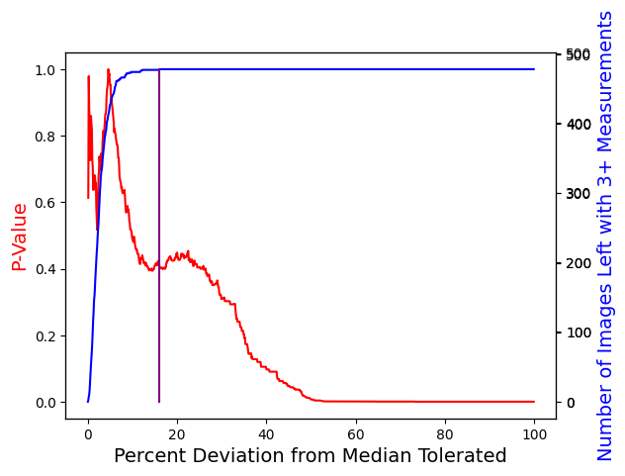
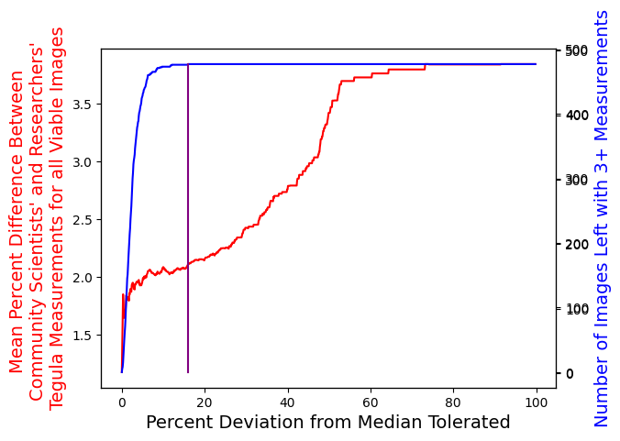
How Can We Determine the Best Method of Measurement Cutoff?
Instead of using precision tolerance (how close 3+ measurements need be for an image to be considered), we switched to percent deviation from the median value.
All images viable at a percent deviation tolerance of 16%.
P-Value = 0.42.
Number of viable images = 479 / 479.
Indicated by the purple line.

Slide 15
Are the datasets normally distributed?
Shapiro-Wilk Test for Community Scientists’ Tegula Measurements P-Value = 4.0 x 10^-10.
Averaged 5 individual measurements to one Tegula Measurement, then checked to see if normally distributed.
Shapiro-Wilk Test for Researchers’ Tegula Measurements P-Value = 1.5 x 10^-14.
Averaged 5 individual measurements to one Tegula Measurement, then checked to see if normally distributed.
P-Value < 0.05 indicates non-normality.
I misinterpreted the results initially (there are two numbers given after running a Shapiro-Wilk Test in Python), I will look into ways of properly comparing the two datasets if they are non-normal.

Slide 16
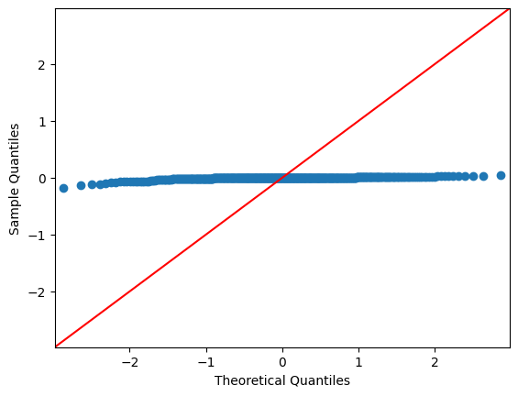
Are the datasets normally distributed?
Sample = Difference between researchers’ mean tegula measurement and community scientists’ mean tegula measurement for each tegula
Plot sample quantiles against theoretical quantiles of a normal distribution
Resulting plot:
Sample is NOT a normal distribution

Slide 17
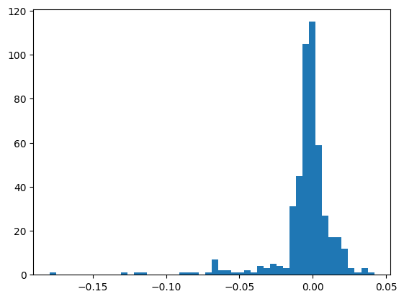
Are the datasets normally distributed?
Distribution of Differences backs this up.
Most data is very close to the center, not normally distributed.
Frequency
Difference
Sample is NOT a normal distribution

Slide 18
Conversion of Mean Absolute Difference to Mean Percent Difference
This makes it more apparent how large the difference between tegula measurements is relative to their means.

Slide 19

What if we don’t cut out tegula measurements > 0.4 cm?
Data actually gets better when selecting measurements closest to the median!
All 479 images usable at 14.5% percent deviation tolerance, down from 16% previously.
Without removal
With removal

Slide 20
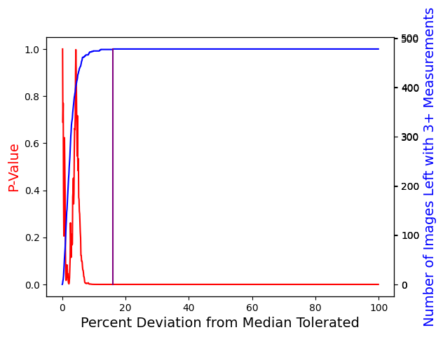
What if we use a Wilcoxon signed-rank test instead of an unpaired T-Test?
This assumes a nonnormal distribution and pairs each measurement up for comparison.
P-Value drops very quickly.
This makes sense, since we expect a very little variation overall and pairing every single measurement adds up variation quickly.

